Slide 1

Road Accident Analysis & Classification
Team SignificantBits
ANUJ JAIN
ARTH SRIVASTAVA
AYUSH PRATAP SINGH
INNOTECH'22 | KIET Group of Institutions

Slide 2

Problem Statement
Accidents are one of the serious issues faced by people in this modern era. The main reasons for this are the negligence and carelessness of people. Even pedestrians are also facing severe injuries and the present system is not effective.
Discovering the associations among the traffic accidents and related injuries is the key factor in reducing the traffic accidents. Identification of injuries severity is a key factor for the proper treatment. As the number of traffic accidents are increasing, injuries severity is a critical factor to identify.

Slide 3

Objective
The main objective of this model is to visualize the data to understand and detect which regions have the most accident-prone area, in what type of weather the accidents are occurring and at what hour/day/week/month/year accident records are more and analyze the data with help of machine-learning algorithms and predict the accuracy of accidents that might occur in the future.

Slide 4
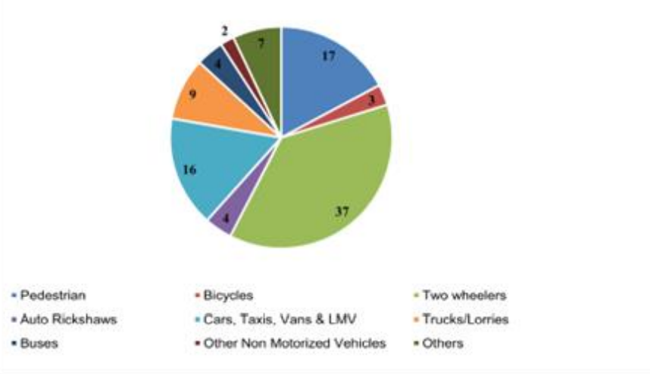
About Project
Accurate analysis is required to deal with massive traffic accidents on the ground. It classifies accidents as fatal, serious, minor injury and motor vehicle accidents.

Slide 5



Methodology
1
3
Data Gathering
The dataset can have the attributes like latitude, longitude, age of driver etc.
Data Training and Analysis
Initialized data is then used for training and analysis.
Data Initialization
Testing & Output
Initializing the given dataset.
Raw data is taken into consideration and preprocessed.
2
4

Slide 6







Thank You
SignificantBits
For: INNOTECH'22 | KIET Group of Institutions

